Slide 1
Software Engineering (CGE2C09)
By Jaelyn lim hui wen, leong min en, loh shi jia, serene, reyner leong

Slide 2
Current situation
Mr. and Mrs. Wang hasn’t been doing well in their business even though their hotel is located at a reasonably good district. The problem they face is due to the poor development of the hotel system therefore leading to poor business. For this project, we will help them to increase customer and allow people to know more about the hotel.

Slide 3
KEY FEATURES
Reservation Management
Track other Revenue Services
Rate Control
Generating Reports
Customer Management
Employee and Housekeeping Tracking
Invoices and Statements
Flexible Payment Options
Notes:
To help them we will introduce system to them
Reservation management
With the new implemented system, you will never lose a reservation again. The system saves all reservations for future retrieval. The software is able to filter, download, and manage past and present reservations.
Reservations, some features are integrated with other functionality such as profiles, cashiering and deposits. This property management software module provides a complete set of features for creating and updating individual, group and business block reservations, including deposit handling, cancellations, confirmations, wait listing, room blocking and sharing.
Front Desk, it will handle individual guests, groups and walk-ins, and has features for room blocking, managing guest messages and wake-up calls, and creating and following up on inter-department advisories, or traces.
Track Other Revenue Services
By using the software, you will be able to create house accounts to manage other sources of revenue that don’t take up your beds. These can include wedding parties, your property’s restaurant, ticketed events, and more.
Rate Control
Be able to enjoy complete control over your rates. We support BAR (best available rate), and custom rates by date and season. Create unique rate plans, specials, and packages, based on your BAR. These also include employee rates, frequent guest rates, and more. When you change your BAR, all your promotions are updated automatically. In addition, it will create time-sensitive promotions, and generate private promotion codes.
Generate Report
Managing your property requires quick access to information. As owners or managers, you want to know exactly how your business is running. With the reports, you’ll see what you need when you need it.
With the reports created, it gives you visibility into the success of your property’s marketing. Get an eagle-eye overview and understand exactly how much business each OTA gave you, so that you never overpay on OTA commissions again. Generate any report you want, including RevPAR and ADR reports. Be able to create reports in-browser, email reports, or download spreadsheets and PDFs. Filter data by marketing channel, room type, year, specials, and more.
Customer management
Keep track of your regular customers. Track how much they are spending and what their preferences are. Use this information to improve your loyalty programs.
Collect everything you need from your guests to process their reservation. This software supports max adults and children, max people per room, and promo codes.
Save your customers in an unlimited customer database which you can filter, download, and manage. Store email addresses. Retrieve them when you want to send email newsletters and promotional campaigns. Leave notes on guest profiles to serve them better.
Profiles, able to complete demographic records for your guests, business accounts, contacts, groups, agents and sources. Profiles include addresses, phone numbers, membership enrollments, stay and revenue details, guest preferences and additional data that make reservations handling and many other activities faster and more accurate.
Employee and Housekeeping Tracking
Important activities are recorded to show the employees responsible for them – keeping your employees accountable for their actions.
Rooms Management, handles all facets of room supervision including availability, housekeeping, and maintenance and facility management. The Queue Rooms feature of the property management software coordinates Front Office and Housekeeping efforts when guests are waiting for rooms which are not immediately available for assignment.
Invoices and Statements
View, review, or print invoices and statements. This software definitely make it easy to manage corporate or group accounts by grouping invoices together. With customer’s profiles, the management can instantly check the balances of their biggest customers.
Accounts Receivable, fully integrated with the OPERA Property Management System database and includes direct billing, invoicing, account aging, bill payments, reminder and statement generation, and account research. Old balances from external accounting systems may be entered.
Flexible Payment Options
Manage payments personally, or use a 3rd-party payment gateway. The software integrates with dozens of payment gateways. There is no need to change the way to accept payments. We securely capture credit card information, and keep it safe for quick retrieval and processing. It supports all major credit cards, and even PayPal
Cashiering, posting guest and passer-by charges (including taxes and other generates), making posting adjustments, managing advance deposits, settlements, checkout and folio printing are a few of the many activities handled by OPERA Cashiering. Cashiering accommodates multiple payment methods per reservation including cash, check, credit cards and direct bill. In multi-property environments, guest charges can be cross-posted from any property in the hotel complex.

Slide 4
Objectives
Improve business
Get more customers
Hotel to be more popular
Get the hotel to be know worldwide

Slide 5
Product Positioning in the Market/Company
Delonix Regia Hotel Management System
For property owners who works in the hospitality industry
Use to manage their own property, regardless of types of property they owned
Various features available in the system which will help to control and maintain the events that occurs.
Strive to manage the various departments available in a hotel efficiently
By improving the service performance, the staff experience in using the interface and the guest experience during their stays
Designed to be user-friendly: allow staff to be able to adapt quickly into using the interface in their daily operations.
Notes:
For property owners who works in the hospitality industry, the Delonix Regia Hotel Management System is the most efficient and effective system that they can use to manage their own property, regardless of types of property they owned, among all the others hotel management system because of the various features available in the system which will help to control and maintain the events that occurs in the various departments of a hotel by facilitating all the activities that are occurring.
Unlike other hotel management system, Delonix Regia Hotel Management System strive to manage the various departments available in a hotel efficiently by improving the service performance, the staff experience in using the interface and the guest experience during their stays as it was designed to be user-friendly, allowing staffs, who are the users, to be able to adapt quickly into using the interface in their daily operations.

Slide 6
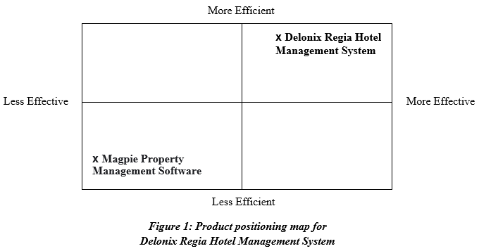
Product Positioning in the Market/Company
Notes:
Delonix Regia Hotel Management System is more efficient and effective in managing a hotel compared to other hotel management system such as the Magpie Property Management Software. This can be seen from the product positioning map below.
There are only a total of five features available in the Magpie Property Management Software which are Accounting, Reports, Reservation Management, Housekeeping and Maintenance. Whereas in Delonix Regia Hotel Management System, more features Customer Management and Global Perspective are provided to cater to the other service areas that are available in a hotel. The user interface in Delonix Regia Hotel Management System is also designed in a way that allows staff to have fun and enjoy while interacting with the system.

Slide 7
Interesting feature
Dashboard:
Helps to organize daily operations
Provide staff with an eagle-eye view of what is going on at their property throughout the entire day
Helps to streamline the operations, preventing errors from happening and saving time
Also contains a calendar
Displays the availability of rooms
Allow staff to optimize the rooms with just a click as the staff are able to drag and drop guests to new rooms and new dates easily
Notes:
One of the interesting features that our product has is the Dashboard which helps to organize daily operations that will occur. It provide staff with an eagle-eye view of what is going on at their property throughout the entire day which helps to streamline the operations, preventing errors from happening and saving time. The Dashboard also contains a calendar which displays the availability of rooms and allow staff to optimize the rooms with just a click as the staff are able to drag and drop guests to new rooms and new dates easily.

Slide 8

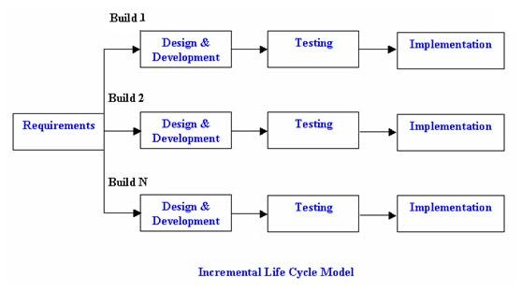
Approach and Methodology of the Project
incremental model
Notes:
My team will be adopting Incremental model for the project. The incremental model is an intuitive approach to the waterfall model. Multiple development cycles take place here, making the life cycle a “multi-waterfall” cycle. Cycles are divided up into smaller, more easily managed iterations. Each iteration passes through the requirements, design, implementation and testing phases.
A working version of software is produced during the first iteration, so you have working software early on during the software life cycle. Subsequent iterations build on the initial software produced during the first iteration. Needs good planning and design. Needs a clear and complete definition of the whole system before it can be broken down and built incrementally. This model can be used when the requirements of the complete system are clearly defined and understood. Major requirements must be defined; however, some details can evolve with time. There is a need to get a product to the market early. A new technology is being used. Resources with needed skill set are not available. There are some high risk features and goals.

Slide 9
Approach and Methodology of the Project
Advantages of Incremental model:
Generates working software quickly and early during the software life cycle.
This model is more flexible – less costly to change scope and requirements.
It is easier to test and debug during a smaller iteration.
In this model customer can respond to each built.
Lowers initial delivery cost.
Easier to manage risk because risky pieces are identified and handled during it’d iteration.

Slide 10
Approach and Methodology of the Project
Disadvantages of Incremental model:
Needs good planning and design.
Needs a clear and complete definition of the whole system before it can be broken down and built incrementally.
Total cost is higher than waterfall.

Slide 11
Approach and Methodology of the Project
When to use the Incremental model:
This model can be used when the requirements of the complete system are clearly defined and understood.
Major requirements must be defined; however, some details can evolve with time.
There is a need to get a product to the market early.
A new technology is being used
Resources with needed skill set are not available
There are some high risk features and goals.

Slide 12
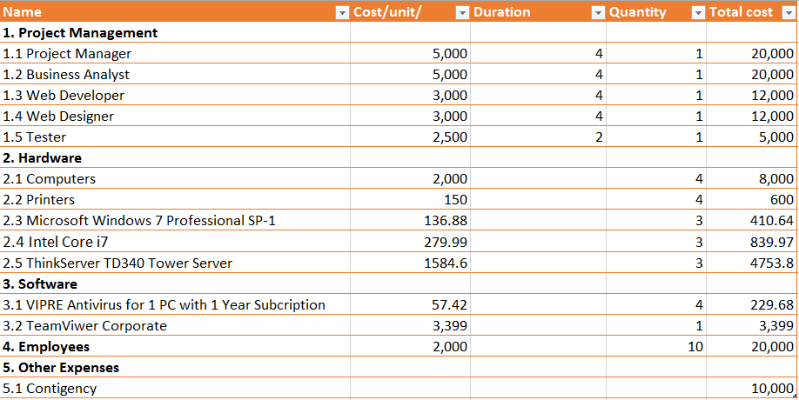
Budget Summary

Slide 13
Risk Management Plan
Type of Risk | Severity of Impact | Likelihood of Occurrence | Risk Reduction
Developer quit | High | High | Try to find a new developer immediately, early scheduling of key personnel
Bug in hotel reservation system | Medium | Medium | Take a page that demonstrates a problem and remove as much content as possible while still reproducing the original problem
Unrealistic time and cost estimates | Medium | Low | Multiple estimation techniques, check recording and analysis of past projects
Developing the wrong software functions | High | Medium | Always make sure to make improvement from the software evaluation

Slide 14
END OF PRESENTATION

